Slide 1
Overview of Traditional Chinese Medicine

Slide 2
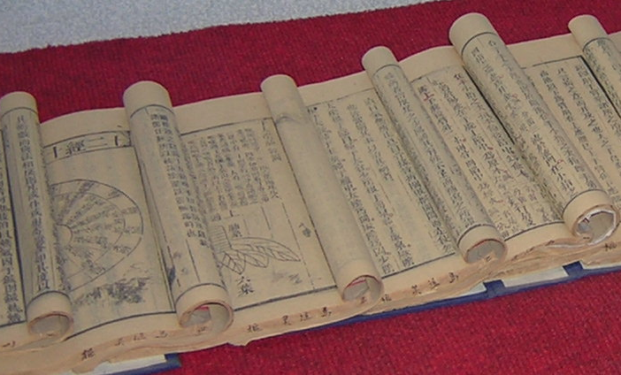
Origin of Traditional Chinese Medicine
Traditional Chinese Medicine,”TCM” has a recorded history dating back over 4,000 years in China. The “Huang Di Nei Jing” or “Yellow Emperors Classic of Medicine” is one of earliest books on the foundation of TCM, originating as early as 1000 B.C.

Slide 3
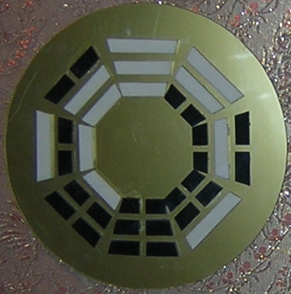
Taoist Philosophy
TCM is derived from Taoist philosophy, and reflects the classical Chinese belief that individual human experiences express causative principles effective in the environment at all scales. These causative principles, whether material, essential, or spiritual, correlate as the expression of the fates as decreed by heaven. BaGua

Slide 4
Development of Traditional Chinese Medicine
Chinese medicine was originally handed down only through personal apprenticeship. Right now China has 25 major colleges of TCM, totaling about 20,000 students in each school at any given time. There are courses ranging from undergraduate to the doctoral, in both Western medicine and TCM.

Slide 5
International State of TCM
Most countries in Asia use the TCM methods of acupuncture and moxibustion, especially in Japan, South Korea, Malaysia, Singapore, ect. In Europe, it is also used regularly. For instance, France, Germany, and England fully recognize its therapeutic value, and there is no predjudice regarding its scientific legitimacy.In the U.S. however, its permeation into the culture has developed from the grass roots up, and from the coasts inward, and only recently reaching into the Midwest.

Slide 6
Basic Characteristics of Chinese Medicine
Zheng Ti Guan Nian (The theory of holism ) :
is a central idea in TCM, and bears directly on preventing and
treating diseases. It has two main components:
1. The human body is regarded as a single, integrated unit, with special emphasis on the harmonious and constant interaction between the Viscera and the superficial structures, as well as their mutual [potential] pathologic influence. Therefore, in TCM the local pathologic changes are always considered in conjunction with the other tissues and organs of the entire body, and never in isolation.
2. Special attention is paid to the integration and interaction of the human body with the external environment. The onset, the evolution, and the changes of a disease are considered in conjunction with the climactic, geographic, social and other environmental factors, rather than considering the disease as an isolated incident.

Slide 7
TCM: Attention to Body and Nature
The human body is an organic whole, its parts are inalienable, and each component of the human body are coordinated, and complement one another both in their optimal functioning, and in their influence on each other pathologically. The changes of nature constantly influences the human body at all times, and they are in fact part of what moves mankind through history. This organic,holistic conception is one of China's ancient legacy to us. Embodied in TCM thought- It runs through physiology , pathology, diagnostics, and all respects of treatment etc…
For Example:
Seasonal variations of the pulse: The physiological changes of pulse according to the changes of the four seasons. The pulse in spring is somewhat taut like a string; in summer, somewhat full; in autumn, somewhat floating or superficial; in winter, somewhat deep.

Slide 8
Bian Zheng Lun Zhi
Planning Treatment According to Pattern Differentiation: In TCM, ”Bian Zheng” means that the patient’s symptoms and signs are analyzed and summarized in order to identify the etiology, the location of the lesion, the pathologic changes and the body condition, etc. Lun zhi means that a proper therapeutic program is determined according to the result of the diagnosis. “Bian zheng” is the way TCM recognizes and analyzes diseases; while Lunzhi, refers to the formulation of a definitive therapeutic program. For example, at the early stage of a disease, the patient may experience fever and chills, no sweating, headache, general body aching, no thirst, thin whitish coating of the tongue, superficial and tense pulse, etc. These symptoms and signs may be differentiated as the “Exterior syndrome of Wind and Cold” according to TCM. “Exterior” as opposed to Interior diseases,” Wind”, as opposed to “Stagnation”, and “Cold” as opposed to “Hot”.The therapeutic principle of relieving such symptoms is to employ diaphoretics of a pungent and hot nature. This is the general principle of “planning treatment according to pattern differentiation (or discrimination).”

Slide 9
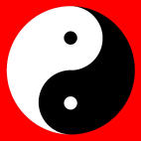
Main Content of TCM: Yin Yang
Originally, it was a philosophical/metaphysical theory of ancient China. Later on, it was incorporated into medical practice and became an important constituent of the theory of TCM. This theory holds that everything in the universe contains the two aspects of Yin and Yang, which are in opposition and also in unison.They are polar opposites discernable in everything, and are never absolute- the ascription of either property always depends on the relative context that each exist in. Hence, all things events,etc., have, as part of their existence a continuous tension and balance between each polarity. This tension, balance, and opposition, are exactly what impels objects in the universe to develop and to change. They represent not only two different matters in opposition but two opposite aspects in the same entity. In TCM, they are used to summarize and explain the problems in the fields of anatomy, physiology, pathology, diagnosis, treatment, etc.The words are best understood by way of qualitative example: dynamic, external, upward, ascending, brilliant, progressive, hyperactive, superficial, heat, light, open, energy, pertain to Yang. Those qualities which are static, internal, downward, descending, dull, retrogressive, hypoactive, dark wet, cold, matter, pertain to Yin.

Slide 10
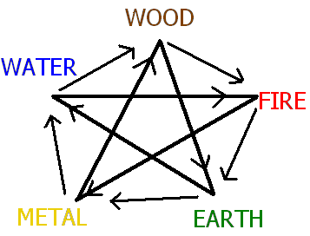
Wu Xing: Five Phases (elements)
Originally it was a philosophical theory in ancient China. Later, it was adapted to medical practice, becoming an important part of the theory of TCM. It relates the properties of the Five Phases ( which,by the way, include: water, wood, fire, earth, metal) to universally
interdependent and mutually restraining relationships of all things and all events. It played a definitive role in the development of TCM.
Wu Xing ( the Five Phases). The ancient thought that the five kinds of materials: metal, wood, water, fire,and earth were the indispensable and most fundamental elements constituting the Universe. They manifested enhancing, inhibiting and restraining relationships among each other. They were also in constant motion and change. In TCM, they are used to explain and expand a series of medical problems by comparing with and deducing from such properties, mutual relationships.

Slide 11
Two examples of relationships between Phases:
Xiang Sheng ( inter-generation ): refers to promoting and accelerating aspects of the mutual generation of objects according to the theory of five elements, i.e., wood generates fire, fire generates earth, earth generates metal, metal generates water, and water generates wood.
Xiang Ke ( inter- inhibition, or control ) : refers to the restraining and controlling relationships among objects according to the theory of the five phases, i.e., wood inhibiting earth, earth inhibiting water, water inhibiting fire, fire inhibiting metal, and metal inhibiting wood.

Slide 12
Jing Luo ( Channels, or Meridians, and their collaterals )
These are the passages through which Qi ( energy ) and Blood circulate, they connect the Viscera with the limbs, connect the upper and lower parts with the interior and exterior of the body, and regulate the mechanisms of the various parts of the body. They include the jing-mai ( the channels or meridians ) and luo-mai ( the collateral channels ); it is specifically through these structures that the human body becomes an an organic whole. Up to now, there has been no objective proof as to the actual existence of Jing and Luo. However, the channels have long been confirmed through clinical useage, and they are also confirmable subjectively.
Jing Mai ( the channels ) : the vertical trunk-lines of the JingLuo system which connect the viscera and have the functions to transport Qi and blood, so as to correlate various parts of the body. The Jing Mai have fourteen channels.
Luo Mai ( the collateral channels ): Branches of the channels of the JingLuo system, which further detail connections between the various parts of body. The Luo Mai have fifteen collateral channels.

Slide 13
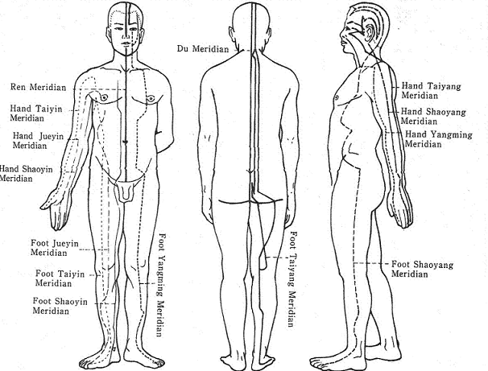
Distribution of the 14 meridians of the hand and foot

Slide 14
Zang Fu ( Viscera )
Internal organs, viscera: in TCM emphasis is laid on the physiological functions of an organ rather than on its anatomical structure.
1. WuZang ( the five parenchymatous organs) : heart, liver, spleen, lung and kidney. According to TCM, these terms may either refer to the actual organs, or chiefly to the external reflections of their functional activities and pathologic processes. Hence, each of them has their own intrinsic characteristics.
2. LiuFu ( the six hollow organs ): gallbladder, stomach, large intestine, small intestine, urinary bladder and triple heater.

Slide 15
Zang Fu relationship with the vital substances of the body
The Zang Fu ensure the proper making of, maintenance, replenishment, movement, and transformation of the vital substances of the body.
Heart governs blood
Liver stores blood &regulates the movement of Qi
Lungs govern Qi & disperse & descend body fluids
Spleen transforms and transports Gu (food) Qi, holds blood in the vessels, and influences body fluids
Kidneys store Essence and influence body fluids

Slide 16
Zang Fu Relationships with Tissues
There are energetic/functional relationships between organs and their corresponding tissue, therefore the health of tissues can be seen through the health of the corresponding Zang Fu.
Heart controls blood vessels and shows its health on the facial complexion
Liver controls the sinews (tendons) and shows its health on the nails
Lungs control the skin and show their health on the body hair
Spleen controls the muscles and shows its health on the lips
Kidneys control the bones and show their health on the hair on the head

Slide 17
Zang Fu Relationships to the Sensory Organs
The health and wellness of sensory organs rely on the care and nourishment of its corresponding Zang Fu.
Heart controls the tongue and taste
Liver controls the eyes and sight
Lungs control the nose and smell
Spleen controls the mouth and taste
Kidneys control the ears and hearing

Slide 18
Zang Fu relationships with the emotions
Qi, the basis for all physiological activities of the body is also responsible for the emotional processes. This notion of the emotions being directly linked to Zang Fu functioning as an integral whole is of utmost importance to Traditional Chinese medical theory. The health of the Zang Fu organs will effect the emotions, and the emotions will effect the health of the Zang Fu organs – especially when they are excessive and occur for long periods of time. Treatment of organs therefore can help emotional health, and the treatment of emotions can improve the health of internal organs. This list of correspondences is, of course,a translation, and other possible choices and lists are possible:
Heart relates to joy
Liver relates to anger
Lungs relate to sadness & worry
Spleen relates to pensiveness, overthinking or obsessiveness, and worry
Kidneys relate to fear

Slide 19
Zang Fu relationships to climate and environment
Different climactic factors effect different Zang Fu organ functions. Excessive weather conditions for prolonged periods of time can adversely effect internal organ processes.
Heart is effected by heat
Liver is effected by wind
Lungs are effected by dryness
Spleen is effected by dampness
Kidneys are effected by cold

Slide 20
Etiology and pathogenesis
In TCM there are ? categories of etiological factors:
Liu Yin: six excessive (or untimely) atmospheric influences. Wind, cold, summer heat, dampness, dryness, and fire
Qi Qing: seven emotions. Over Joy, anger, melancholy, anxiety, sorrow, fear and fright. The emotions are considered to be endogenous factors causing diseases if in excess
Injury: which includes acute and chronic

Slide 21
Excessive joy impairs the heart:
Over joy make Qi of heart sluggish ( e.g. unable to concentrate the mind )
Anger impairs the liver: rage causes the Qi of Liver to flow adversely upward, causing a stuffy feeling in the chest, headache and redness of eyes may occur.
Anxiety impairs the spleen: anxiety makes the Qi of spleen depressed, often resulting in indigestion.
Sorrow impairs the lung: sorrow consumes the Qi of lung.
Fear impairs the kidney: fear causes the Qi of the kidney to sink, and as a result, incontinence of urine and stool and seminal discharge may occur.
Fright impairs the heart: fright make the Qi of the heart disturbed, resulting in palpitation, restlessness, and even mania.

Slide 22
Method of TCM to diagnose
• Si Zhen: six methods of diagnosis. Looking ( inspection ). Listening (auscultation ), smelling (olfaction), asking (interrogation), pulse taking and palpation.
Looking: examination by eye, including inspection of complexion, facial expression, behaviors, body surface, tongue, excreta and secretions.
Listening ( auscultation): listening to the patient’s voice, sounds of breath and cough, etc.
Smelling (olfaction): smelling of odor, secretion and excretion of the patient , as a reference for diagnosis.
Asking ( interrogation): questioning the patient regarding their condition.
Pulse taking: feeling the pulse. The diagnostic method used where a physician touches and compresses the patient’s radial pulse proximal to the carpal joints, so as to assess its changes.
Palpation: touch patient’s skin to know patient’s swelling and pain.
• Ba Gang: eight guiding principles, or eight parameters for diagnosis are Yin and Yang, exterior and interior, cold and heat, deficiency and excessiveness.

Slide 23
Method of Treatment
The main method that Chinese medicine treats are the
acupuncture, herbs, Tui Na.

Slide 24
How does TCM work?
TCM recognized the vital energy called Qi as the life force that drives all living things. Qi flows through meridians (also called channels) in the body similar to water flowing in a river. There are twelve primary meridians, each associated with an organ system. Disease occurs with imbalance, resulting in excess of deficient amounts of Qi in the meridians. TCM works to alleviate this imbalance and restore harmony using acupunture and herbs.

Slide 25
How does Acupuncture work?
Acpuncture points are located throughout the body and act as gateways to influence, redirect, increase or decrease the vital “substance” of Qi, thus correcting imbalances that cause disease. Thin, solid, sterile, stainless steel acpuncture needles are inserted into acupuncture points to mobilize energy (Qi) flow and invigorate the proper function of muscles, nerves, vessels, glands and organs. Most patients do not feel the needles during treatment. Many western based research programs have been conducted towards understanding the mechanism of acupuncture with impressive results. Acupuncture is quickly becomin known as a very important healing modality or many diseases.

Slide 26
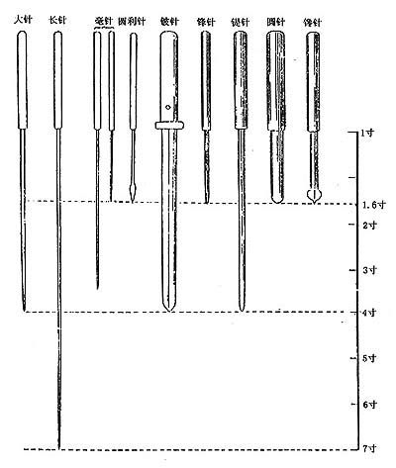
Ancient Acupuncture: Nine needles

Slide 27
About Chinese Herbs
Herbs are an important component of TCM used in the prevention and treatment of disease. Ancient Chinese herbal formulas are as effective now as they were more then 4,000 years ago when they were first introduced. The formulas contain two to eighteen different types of herbes and are used to treat a wide variety of symptoms while stimulating the body’s natural healing process. Herves are not addictive, but are powerful nutritional agents. Balance is the key to using herbal nutrients for healing. As with other natural therapies, there is sometimes a “healing crisis” known as the “Law of Cure.” Sometimes you will seem to get worse before you get better.

Slide 28
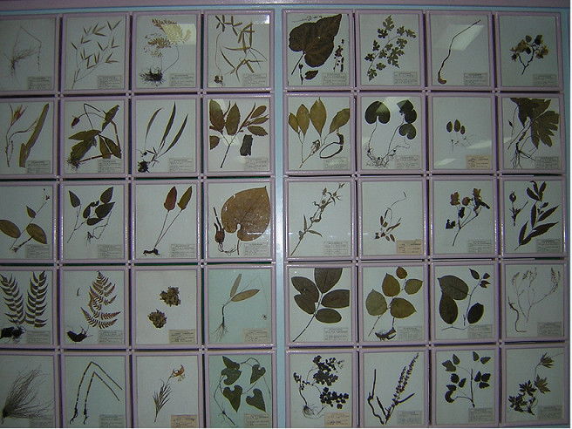
Chinese Herb Leaves

Slide 29
What is Tui Na?
Tui Na is relatively new to the western world and combines the work of massage therapy, chiropractic and TCM. Tui Na is Oriental bodywork therapy that uses the TCM theory of the flow of Qi through the meridians as its basic therapeutic orientation. Through the application of massage and manipulation techniques Tui Na seeks to establish a more harmonious flow of Qi throught the system of channels and collaterals, allowing the body to naturally heal itself.
Tui Na encompasses three techniques 1) Massage to treat the soft tissue (muscles and tendons of the body. 2) Acupressure to affect the flow of the Qi and 3) Adjustments to realign the musculoskeletal and ligamentous relationships and spine subluxations to restore the body’s normal functions.

Slide 30
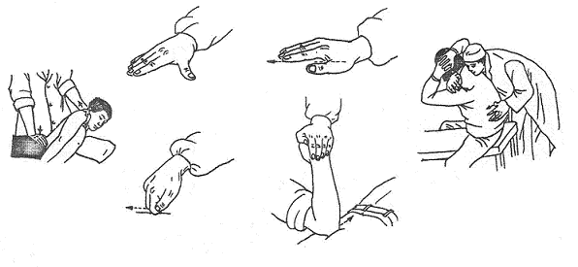
Tui Na Hand Positions

Slide 31
TCM Broad Range of Treatments
Asthma | Allergies | Cold/Flu
Cough/Bronchitis | Headaches | TMJ
Tinnitus | Arthritis | Osteoporosis
Back/neck ache | Sciatica | Pain Mgmt
Infertility | Depression | Stress
Addictions | Skin diseases | Fibromyalgia
PMS | Rhinitis | Vision
Hemilplegia | Sexual dysfunction | High blood pressure
Stroke | High Cholesterol | Injuries
Trauma | Children's Diseases | Frozen Shoulder

Slide 32
About Dr. Chen
Degrees
Gansu College of Traditional Chinese Medicine, O.M.D., 1985 in LanZhou, China
Current Position
Director, East West Healing Center
O.M.D., L.Ac. Licensed for Acupuncture and Bodywork in the United States
Previous Positions
July 2002 - Full Professor of Traditional Chinese Medicine, Hospital of Gansu College of Traditional Chinese Medicine in China
1998-2002 - Associate Professor of Traditional Chinese Medicine, Hospital of Gansu College of Traditional Chinese Medicine in China
1999-2002 - Supervisor for Master Students in Chinese Orthopedics and Traumatology, Gansu College of Traditional Chinese Medicine in China
1991-1997 - Chief Doctor and Departmental Head, Gansu Province LanZhou Chinese Medicine Orthopedics and Traumatology Hospital in China
1989-1990 - Team doctor, Gansu Province wrestling team in China
1986-1989 – Resident, Gansu Province LanZhou Chinese Medicine Orthopedics and Traumatology Hospital in China

Slide 33
About Dr. Chen (cont.)
Book Publications
1. Chief Editor, Clinical Orthopedic Diagnostic Methods – A Practical Guidebook, Gansu Province People Publisher, 2001
2. Chief Editor, Chinese Reduction Manipulation for Bone-setting, LanZhou University Press, 2002
3. Editor, Scientific Dictionary of Chinese Orthopedics and Traumatlogy, Chinese Medicine Press, 2001
4. Editor, Joint Dislocation and Sprain Injury, LanZhou University Press, 2000
Editor, Modern Traditional Chinese Orthopedics, Chinese Medicine Press, 2004
21 professional journal publications
6 Chinese national awards
1 Chinese herbal formula patent

Slide 34
